Slide 1
Types of Environments in AI
Dr. Samriddhi Sarkar
Assistant Professor Senior Grade
SCOPE, VIT Vellore

Slide 2
Types of Environments
An environment in artificial intelligence is the surrounding of the agent.
The agent takes input from the environment through sensors and delivers the output to the environment through actuators.
There are several types of environments:
Fully Observable vs Partially Observable
Deterministic vs Stochastic
Competitive vs Collaborative
Single-agent vs Multi-agent
Static vs Dynamic
Discrete vs Continuous
Episodic vs Sequential
Known vs Unknown

Slide 3
1.Fully Observable vs Partially Observable
When an agent sensor is capable to sense or access the complete state of an agent at each point in time, it is said to be a fully observable environment else it is partially observable.
Maintaining a fully observable environment is easy as there is no need to keep track of the history of the surrounding.
An environment is called unobservable when the agent has no sensors in all environments.
Examples:
– Chess – the board is fully observable, and so are the opponent’s moves.
– Driving – the environment is partially observable because what’s around the corner is not known.

Slide 4
2. Deterministic vs Stochastic
When a uniqueness in the agent’s current state completely determines the next state of the agent, the environment is said to be deterministic.
The stochastic environment is random in nature which is not unique and cannot be completely determined by the agent.
Examples:
– Chess – there would be only a few possible moves for a coin at the current state and these moves can be determined.
– Game of dice- there is always 1/6 probability involved

Slide 5
3. Competitive vs Collaborative
An agent is said to be in a competitive environment when it competes against another agent to optimize the output.
The game of chess is competitive as the agents compete with each other to win the game which is the output.
An agent is said to be in a collaborative environment when multiple agents cooperate to produce the desired output.
When multiple self-driving cars are found on the roads, they cooperate with each other to avoid collisions and reach their destination which is the output desired.

Slide 6
4.Single-agent vs Multi-agent
An environment consisting of only one agent is said to be a single-agent environment.
A person left alone in a maze is an example of the single-agent system.
An environment involving more than one agent is a multi-agent environment.
The game of football is multi-agent as it involves 11 players in each team.

Slide 7
5.Dynamic vs Static
An environment that keeps constantly changing itself when the agent is up with some action is said to be dynamic.
A roller coaster ride is dynamic as it is set in motion and the environment keeps changing every instant.
An idle environment with no change in its state is called a static environment.
An empty house is static as there’s no change in the surroundings when an agent enters.

Slide 8
6. Discrete vs Continuous
If an environment consists of a finite number of actions that can be deliberated in the environment to obtain the output, it is said to be a discrete environment.
The game of chess is discrete as it has only a finite number of moves. The number of moves might vary with every game, but still, it’s finite.
The environment in which the actions are performed cannot be numbered i.e. is not discrete, is said to be continuous.
Self-driving cars are an example of continuous environments as their actions are driving, parking, etc. which cannot be numbered

Slide 9
7.Episodic vs Sequential
In an Episodic task environment, each of the agent’s actions is divided into atomic incidents or episodes.
There is no dependency between current and previous incidents.
In each incident, an agent receives input from the environment and then performs the corresponding action.
Example: Consider an example of Pick and Place robot, which is used to detect defective parts from the conveyor belts. Here, every time robot(agent) will make the decision on the current part i.e. there is no dependency between current and previous decisions

Slide 10
7.Episodic vs Sequential (contd…)
In a Sequential environment, the previous decisions can affect all future decisions.
The next action of the agent depends on what action he has taken previously and what action he is supposed to take in the future.
Example:
– Chess- Where the previous move can affect all the following moves.

Slide 11
8. Known vs Unknown
In a known environment, the output for all probable actions is given.
Obviously, in case of unknown environment, for an agent to make a decision, it has to gain knowledge about how the environment works

Slide 12
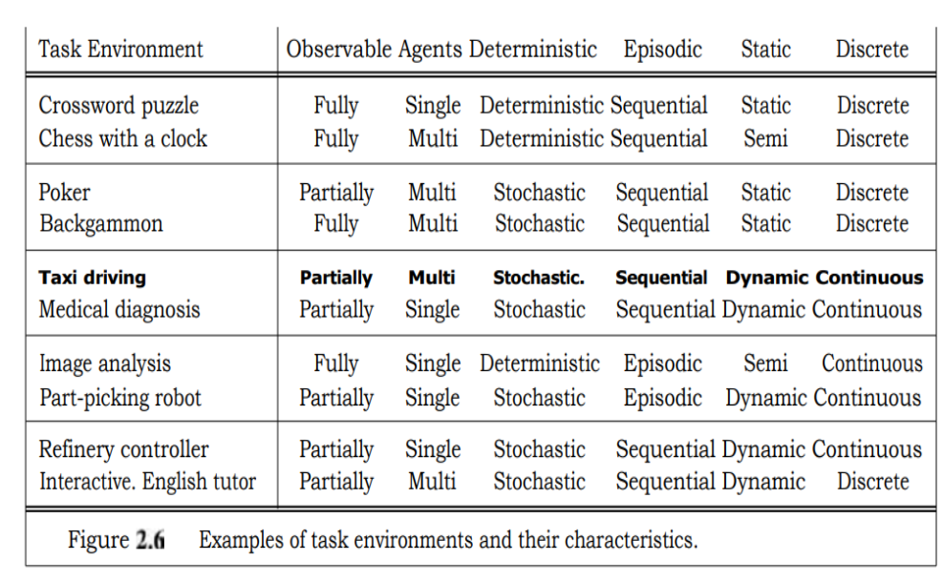
Examples:

